Slide 1
Activity and capacity modelling for the New Hospital Programme
Steven Wyatt & Tom Jemmett
NHSR Conference 2022

Slide 2
How much, and what types of activity
might a hospital need to accommodate
in the future?
Notes:
This is question we’re attempting to answer – or rather support others to answer
Clear relevance to NHP – hospital design, site planning, architecture, capital and revenue planning
But it’s a question that regularly asked outwith hospital building programme – medium and linger term financial planning, service reconfigurations, testing service resilience, commissioning plans
Talk through what we’ve done for NHP – your view on wider applicabiliy

Slide 3
What happens now?
Lots of models
Lots of consultancy support
Lots of similarities - but….
Lots of repetition / duplication
Methodological progress is slow
Much is rudimentary
No base to build from
Common issues with models
Handling uncertainty
Unnecessary aggregation
Poor coverage of some changes
Systematic bias in model assumptions
Lack of ownership and auditability of assumptions
Conflating demand forecasts with affordability
Notes:
Our take on what happens now
Academic developments

Slide 4
Baseline activity & capacity
Demand-supply imbalances
Need-supply imbalances
Demographic change
Non-demographic change
Activity mitigators
Resource use
Waiting list management
Gaps in care
Population size
Medical interventions
Activity avoidance
Utilisation rates
Repatriation / expatriation
Inequalities
Population age profile
Clinical standards
Activity type changes
Resource availability
Private funding dynamics
Treatment thresholds
Age-specific health status
Patient expectations
Efficiency improvements
Modelled future activity
Modelled future capacity

Slide 5
How to model the changes?
How much change to model?
Notes:
Two distinct challenges.
The first rests with us (the model developers) – a technical challenge
If we get a consensus that the initial methods are good enough, then as a community – we can slowly, steadily improve on the process
The second falls to model users – that is inherently difficult
We don’t expect certainty – recognise and incorporate the users uncertainty in how the future might unfold
The model providers the user with a range of relevant information (time series, hospital comparison, evidence) – so that their inputs are grounded

Slide 6
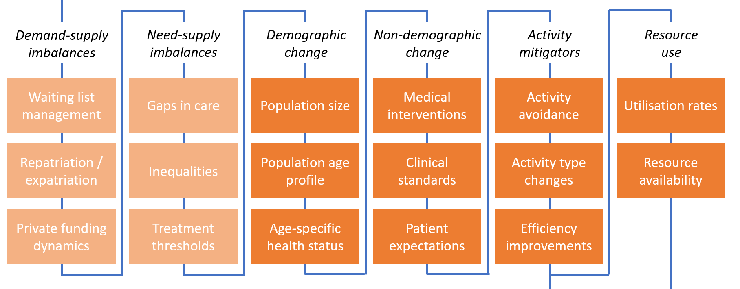
Scenario mode
Model inputs
Model engine
Model output
Baseline activity & capacity
Modelled future activity and capacity
Modelled future activity and capacity
Input parameters

Slide 7
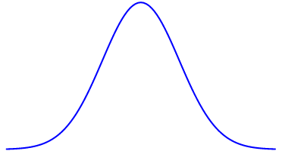
Monte-Carlo simulation mode
Model inputs
Model engine
Model output
Modelled future activity and capacity
Baseline activity & capacity
Monte-Carlo simulation
Modelled future activity and capacity
Distribution of futures
Input parameters
Modelled future activity and capacity

Slide 8
The data science
Code on Github
R, Python & TSQL
Hosted on MS Azure
Model UI – RStudio Connect
Raw data: HES - but could be SUS
For a typical model
c. 1¼ m records ingested
c. 100 transformations applied
n (say 200) model runs
c. ¼bn. records in output

Slide 9
Baseline activity & capacity
Demand-supply imbalances
Need-supply imbalances
Demographic change
Non-demographic change
Activity mitigators
Resource use
Waiting list management
Gaps in care
Population size
Medical interventions
Activity avoidance
Utilisation rates
Repatriation / expatriation
Inequalities
Population age profile
Clinical standards
Activity type changes
Resource availability
Private funding dynamics
Treatment thresholds
Age-specific health status
Patient expectations
Efficiency improvements
Modelled future activity
Modelled future capacity

Slide 10
Baseline activity & capacity
Demand-supply imbalances
Need-supply imbalances
Demographic change
Non-demographic change
Activity mitigators
Resource use
Waiting list management
Gaps in care
Population size
Medical interventions
Activity avoidance
Utilisation rates
Repatriation / expatriation
Inequalities
Population age profile
Clinical standards
Activity type changes
Resource availability
Temporary solution
Private funding dynamics
Treatment thresholds
Age-specific health status
Patient expectations
Efficiency improvements
Modelled future activity
Modelled future capacity

Slide 11
Where from here?
2 model releases so far
Further releases every 3/6 months
NHP team sharing the model with participating trusts
Discussion with NHSE about wider applications of the model
A further session planned to share the model code and infrastructure

Slide 12
Thank you Please find Tom or Steven during the breaks if you’d like to find out more.

